Slide 1

JavaScript Applications
Course Overview
SoftUni Team
Technical Trainers
Software University
http://softuni.bg

Slide 2
Table of Content
Introduction
Training & Team
Course Objectives
Course Organization

Slide 3
Have a Question?
sli.do
#JS-CORE

Slide 4












SoftUni Diamond Partners

Slide 5




SoftUni Organizational Partners

Slide 6

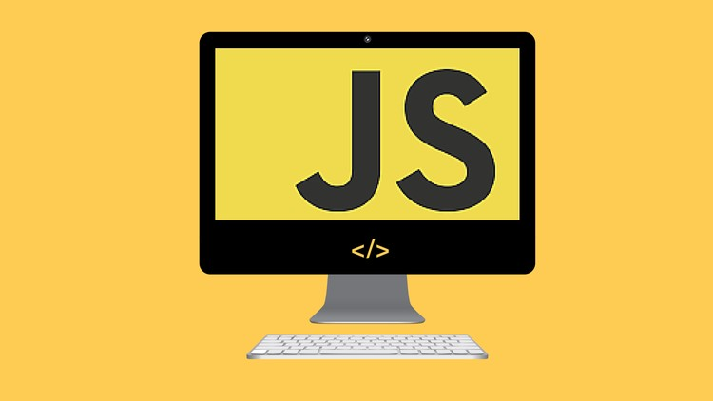
JS Applications
Course Objectives & Program

Slide 7

What are we going to learn?
REST Services and AJAX - HTTP, REST and RESTful Services, AJAX and Fetch API
Asynchronous Programming - Promises, Async/Await
Remote Databases - Firebase and Kinvey
Routing and Architecture - Routing Concepts and Navigation using Sammy.js

Slide 8
What are we going to learn? (2)
Templating - Templating Concepts, Template Engines, Handlebars Overview
Webpack - Introduction and Basic Builds
Creating Single-Page-Application (SPA)
JS for Front-End - Bootstrap, Grid System, Styling Components

Slide 9

Trainers and Team

Slide 10
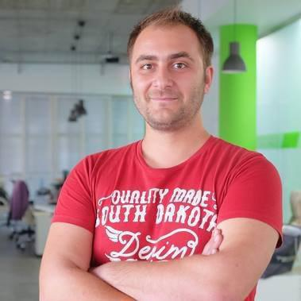
Doncho Minkov
Senior Full-Stack Developer in SoftUni
+10 year in IT - 8+ years experience as Technical Trainer @ Telerik Academy
Fluent in Node.js, .NET, Angular, Java, C++
Experience with all popular mobile platforms (Android, iOS, Windows)
"30 under 30" - Forbes 2017 - Education
Front-end Developer by heart
Software Developer by need
@SoftUni mostly working with React & ASP.Net Core

Slide 11
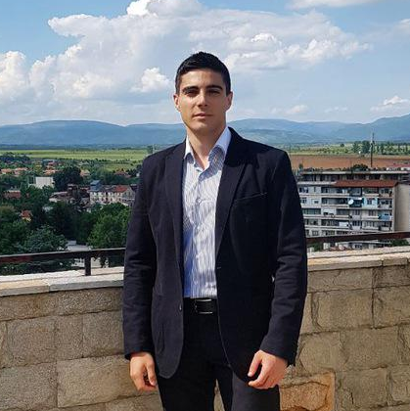
William Abboud
Full Stack & Senior Front-End Developer @ SoftUni
Studied Computer Science in Newcastle University
Passionate about Front-End Technologies (HTML/CSS/JS/React.js) and UX/UI Design

Slide 12
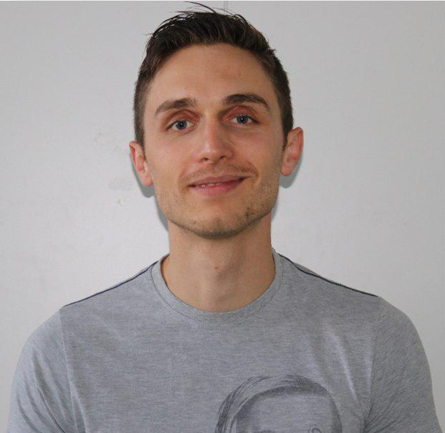
Ivaylo Dimitrov
5+ years experience in the IT (HTML, CSS, JavaScript, C#, SQL, Windows Server)
Excellent Software University student
Technical Trainer in Software University

Slide 13

Course Objectives
Course Details and Schedule

Slide 14
Targets of the course
The JavaScript Applications course provides
Technologies for creating Single Page Apps (SPA)
Consuming RESTful Services (REST) with AJAX
Creating UI templates
Common JS programming patterns and routing

Slide 15

Exam
Structure: SPA (Single Page Application) for 4 hours
Implement CRUD operations + login / register / logout
Use AJAX and REST + cloud-based back-end (Kinvey)
Optionally:
Use templates for rendering
Use MVC architecture + routing
https://judge.softuni.bg/Contests/Practice/Index/1656#0

Slide 16

Course Organization

Slide 17

Structure of the course
Lectures:
Twice a week (4 hours each) in Tech + Knowledge Hall
Tuesday and Friday (18:00 - 22:00)
Learn new material
Exercises:
Twice a week (4 hours each) in Experience Hall
Monday and Thursday (13:30 - 17:30)
Practice learned material
Ask questions if any

Slide 18

Evaluation Criteria
Mandatory
Final exam - 95%
Exercises/Homework - 5%
Bonuses:
Presence in class - 5% bonus (onsite students only)

Slide 19
https://softuni.bg/courses/js-applications

Slide 20




Trainings @ Software University (SoftUni)
Software University – High-Quality Education and Employment Opportunities
softuni.bg
Software University Foundation
http://softuni.foundation/
Software University @ Facebook
facebook.com/SoftwareUniversity
Software University Forums
forum.softuni.bg

Slide 21

License
This course (slides, examples, demos, videos, homework, etc.) is licensed under the "Creative Commons Attribution-NonCommercial-ShareAlike 4.0 International" license

